Slide 1
Predicting Osteoporosis Risk

Slide 2
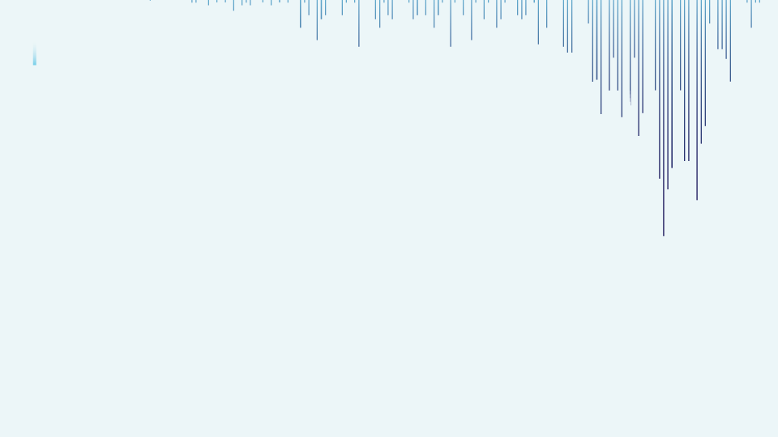



Predicting Osteoporosis Risk Analysis
“In the evolving landscape of healthcare, this project uses machine learning to anticipate osteoporosis risk early and help doctors take proactive measures to improve patient outcomes.”
Presented By : Pratik D. Bokade

Slide 3

Introduction
Data Gathering /Data Refinement
01
Reason / Issues causing Osteoporosis Diseases
02
Models and early detection bring essential benefits
Comprehensive Dataset Overview
Refinement and Data Preparation Steps
EXPLORATORY DATA ANALYSIS
Feature Extraction
03
04
Find patterns and identify trends
Divide Features into X and Y
Gain valuable insights from the dataset
Machine Learning / Deep learning
Methodology
06
Experimental results
05
Algorithms or Models Used
Visuals of Compared models
Compare each Evaluate Algorithm
Accuracy, confusion matrix of models
Conclusion
Appendices and references
07
08
Importance of the used approach
Suggestion for future
Links and codes used in the project

Slide 4


Monitor and Update
STEP
Continuously monitor the model's performance in the real-world scenario
07
Model Evaluation
STEP
06
Assessing the performance of a machine learning model using metrics
Model Selection and
Model Training
STEP
Choosing a suitable machine learning algorithm and optimizing its parameters
05
Split Train And Test Data
WORK FLOW
WORK FLOW
STEP
04
Dividing the dataset into training and testing sets to evaluate
PREPROCESSING
STEP
Preparing and cleaning data to enhance its quality and suitability
03
Exploratory Data Analysis
STEP
02
Analyzing and visualizing data patterns to understand its characteristics
Data Collection
STEP
Gathering and organizing data to train machine learning models.
01

Slide 5
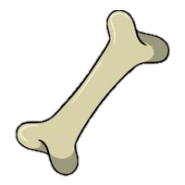

INTRODUCTION
Hormonal Changes
Age
What is Osteoporosis?
A condition in which bones become weak and brittle, leading to fractures.
Why is early detection important?
Fractures caused by osteoporosis are serious and costly, especially in older adults.
Goal of the Project:
To build a model that can predict the risk of osteoporosis in patients using demographic, medical, and lifestyle data.
Factors Of Osteoporosis.
Physical Inactivity
Medications
Low Calcium & Vitamin D Intake
8.9M+
Alcohol
50%
Never Fully Recover
Fractures Caused By Osteoporosis
(each year)

Slide 6
Data Collection & Refinement
1958
16
Osteoporosis Risk Prediction
ROWS
Osteoporosis_1
COLUMNS
Features
(Columns)
Age
Demographic Information
X
Gender
Clinical Data
Hormonal Changes, Family History, Calcium & Vitamin D Intake, Physical Activity, Medical Conditions, Medications, Prior Fractures
Osteoporosis
0 - No
Y
Outcome Variable
1 - Yes

Slide 7
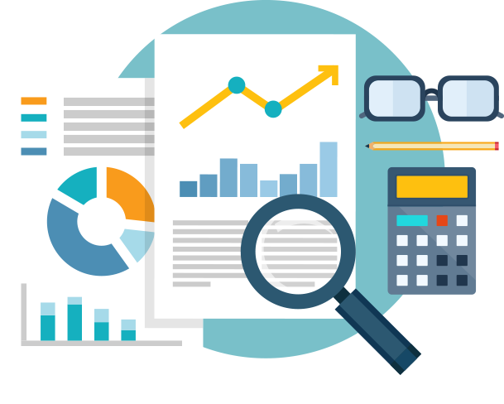
EXPLORATORY DATA ANALYSIS
Distribution of Age: Mostly clustered around older ages (peaks near 60s – 70s)
Calcium / Vitamin D Intake: Lower intake found in patients with osteoporosis
Physical Activity & Lifestyle: Sedentary lifestyle linked to higher risk
Correlation Heatmap Insight:
Positive correlation: Age, Prior Fracture
Negative correlation: Physical Activity, Calcium, Vitamin D

Slide 8

PREPROCESSSING
Dropped irrelevant columns (like ID)
Encoded categorical variables (Yes / No, Male / Female → 0 / 1)
Checked and handled missing values
Converted body weight categories into numbers
No columns were dropped due to relevance

Slide 9
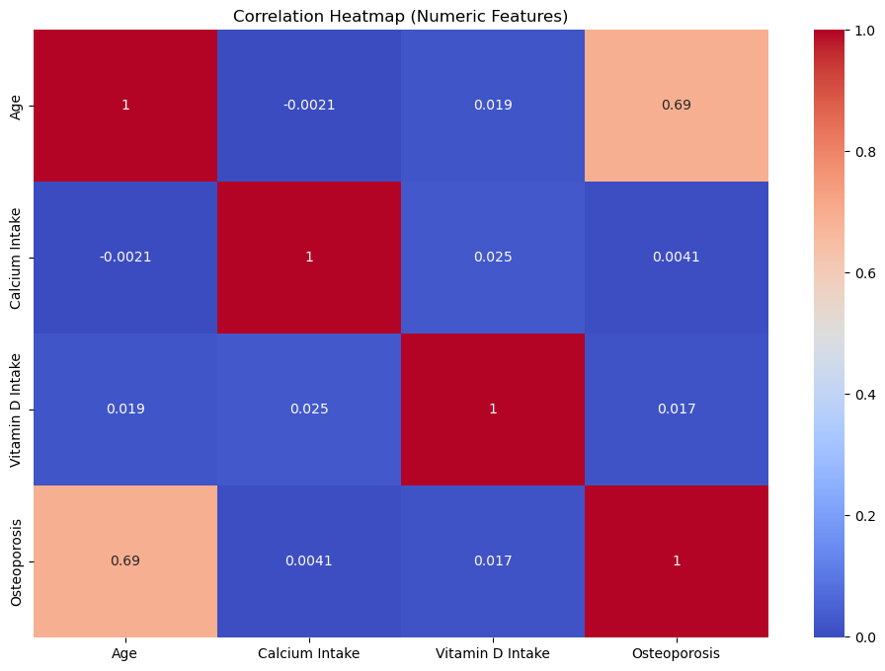
CORRELATION HEATMAP
Age shows a strong positive correlation with osteoporosis risk.
Calcium intake is negatively correlated, indicating a protective effect.
Bone density (BMD/T-score) has a strong negative correlation with risk.
BMI is moderately negatively correlated, suggesting higher BMI lowers risk.

Slide 10
Feature Engineering
Split into X (features) and y (target = osteoporosis)
Train-test split: 80% training, 20% testing
Checked for feature importance
(using models like Random Forest)

Slide 11
MODEL SELECTION
Models used:
Logistic Regression: Simple and interpretable
Decision Tree: Great for visual logic and categorical data
Random Forest: Powerful ensemble model
Support Vector Machine (SVM): Best for small complex datasets

Slide 12
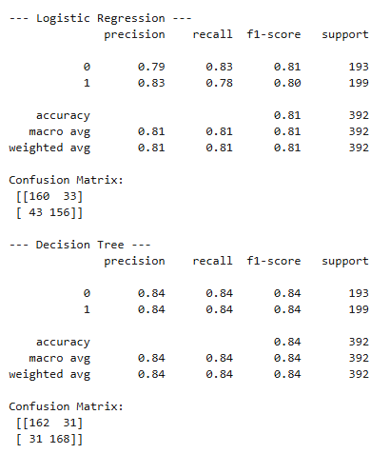
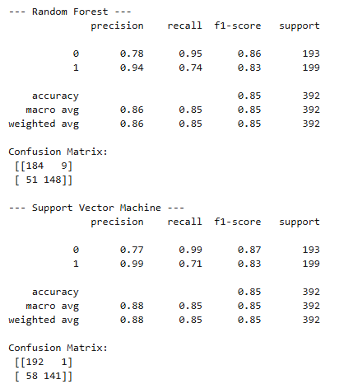
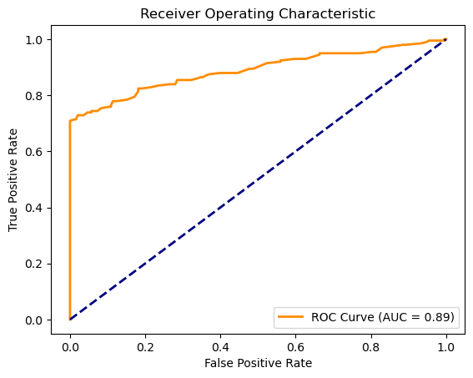
Confusion Matrix & ROC Curve:

Slide 13


Accuracy
Precision
Recall
F1-Score
%
%
%
%
Understanding
Support Vector Machine | 85 | 88 | 85 | 85
Random Forest Classifier | 85 | 86 | 85 | 85
Decision Tree | 84 | 84 | 84 | 84
Logistic Regression | 81 | 81 | 81 | 81
Precision: How often the model is correct when it predicts someone has osteoporosis.
Recall: The model’s ability to find all actual osteoporosis cases.
F1 Score: A balance between precision and recall — useful when it’s important to avoid both false positives and false negatives.
Experimental Results :
SVM Dominates: Achieved 85% accuracy with the highest precision (88%), making it excellent for minimizing false positives. Ideal for cautious medical screening.
Random Forest & Decision Tree Consistency: Both models show strong performance (85–84% accuracy).
Random Forest: Higher recall (85%) – better at detecting actual cases.
Decision Tree: Balanced precision and recall (84%) – interpretable and reliable.
Logistic Regression: Simple and interpretable with 81% accuracy and precision, but slightly lower recall (81%) – may miss some at-risk patients.

Slide 14





Conclusion
Conclusion
Key Findings
Random Forest & SVM achieved the best accuracy (85%), with SVM having the highest precision (88%).
The study utilized the Osteoporosis Risk Prediction dataset with 1958 instances, and all models were implemented on Jupyter Notebook
Age, prior fracture, hormonal changes, calcium & vitamin D were the top predictors.
All models performed above 80% accuracy, proving the model's reliability.
Limitations
Limited Dataset Size:
The model was trained on a single dataset with limited instances, which may affect generalizability.
Missing Lifestyle/Genetic Factors:
Important factors like bone density scores, genetic history, and detailed nutrition/lifestyle were not available in the dataset.
No External Validation:
The model was tested only on a split portion of the same dataset — not on real-world or unseen clinical data.
Future research
Future research should use larger, diverse clinical datasets and include features like DEXA scans, diet, and genetics to improve accuracy. Incorporating explainable AI will enhance transparency and clinical trust.

Slide 15
Questions ?

Slide 16

Thank You!

